Slide 1
Angular in Full-Stack Architecture
Angular CLI tool (ng)
Angular Reuse of UI through components
Angular HttpClient
Angular Router
Angular Reactive Forms
Material Autocomplete
Material Toolbar
Material Sidenav

Slide 2
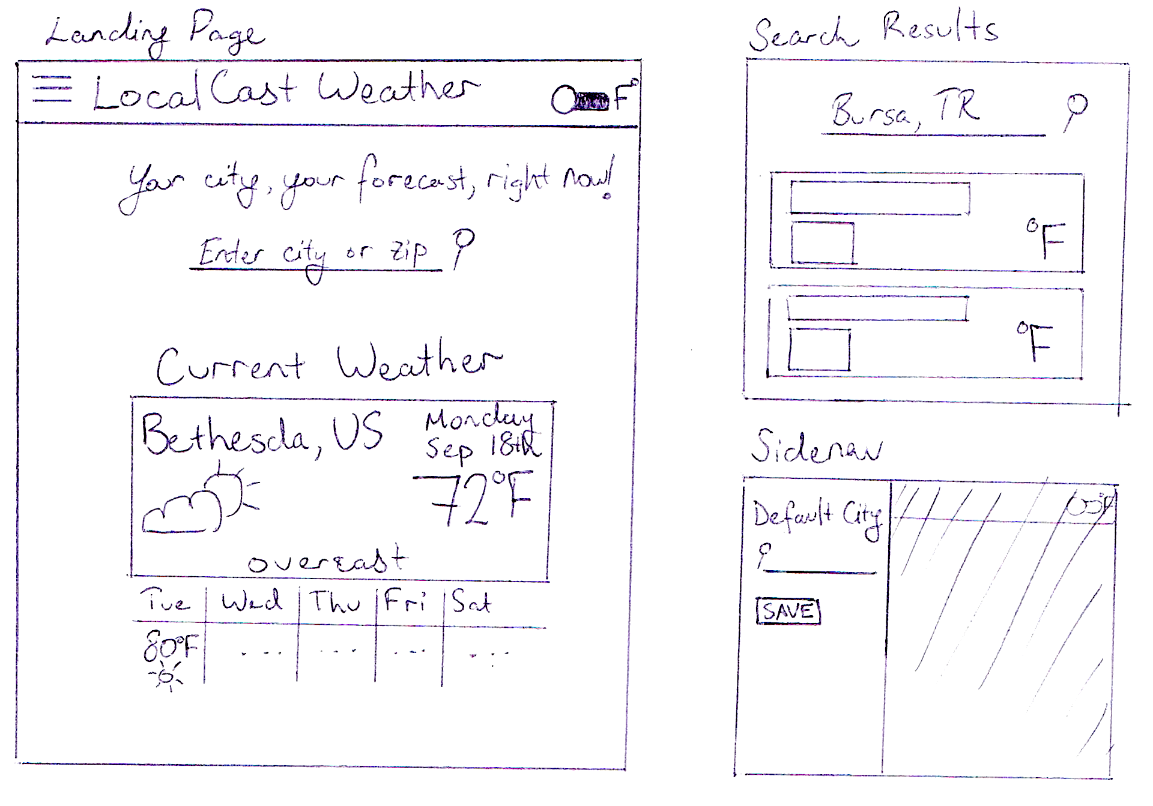
Wireframe example

Slide 3
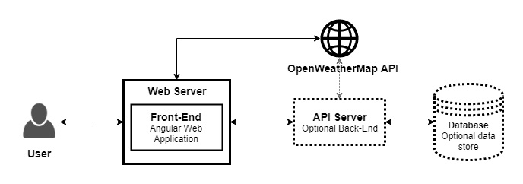
High level architecture
hard-decoupling
Frontend code separate
never

Slide 4
Folder structure
Keep frontend and backend code in different repositories
If in the same repositories, keep different folders
Set up development directory
dev
Windows
PS> mkdir c:\dev
PS> cd c:\dev
macOS
$ mkdir ~/dev
$ cd ~/dev

